Slide 1
Data Structure Fundamentals
Linked List

Slide 2
Introduction
Linked list is a linear data structure which is used to maintain a list in the memory.
It can be seen as the collection of nodes stored at non-contiguous memory locations.
Each node of the list contains a pointer to its adjacent node.
Suppose a programmer made a request for storing the integer value then size of 4-byte memory block is assigned to the integer value.
These elements are linked to each other by providing one additional information along with an element, i.e., the address of the next element. The variable that stores the address of the next element is known as a pointer. Therefore, we conclude that the linked list contains two parts, i.e., the first one is the data element, and the other is the pointer.

Slide 3
Declaration of Linked List
In C:
structnode{
int data;
struct node *next;
}
In Java:
class Node{
int data;
Node next;
}

Slide 4
Advantages of Linked List over Array
Dynamic data structure: The size of the linked list is not fixed as it can vary according to our requirements.
Insertion and Deletion: Insertion and deletion in linked list are easier than array as the elements in an array are stored in a consecutive location. In contrast, in the case of a linked list, the elements are stored in a random location. The complexity for insertion and deletion of elements from the beginning is O(1) in the linked list, while in the case of an array, the complexity would be O(n). If we want to insert or delete the element in an array, then we need to shift the elements for creating the space. On the other hand, in the linked list, we do not have to shift the elements. In the linked list, we just need to update the address of the pointer in the node.
Memory efficient: Its memory consumption is efficient as the size of the linked list can grow or shrink according to our requirements. Implementation Both the stacks and queues can be implemented using a linked list.

Slide 5
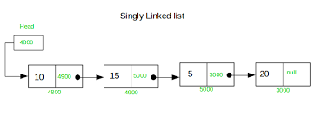
Singly Linked List
The singly linked list is a data structure that contains two parts, i.e., one is the data part, and the other one is the address part, which contains the address of the next or the successor node. Suppose we have three nodes, and the addresses of these three nodes are 100, 200 and 300 respectively.
The representation of four nodes as a linked list is shown in the below figure:

Slide 6
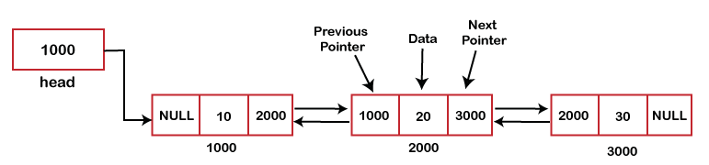
Doubly Linked List
We can define the doubly linked list as a linear data structure with three parts: the data part and the other two address part. In other words, a doubly linked list is a list that has three parts in a single node, includes one data part, a pointer to its previous node, and a pointer to the next node.
Suppose we have three nodes, and the address of these nodes are 1000, 2000 and 3000, respectively. The representation of these nodes in a doubly-linked list is shown below:

Slide 7
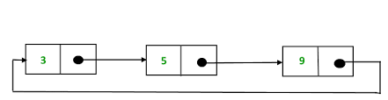
Circular Linked List
A circular linked list is a variation of a singly linked list. The only difference between the singly linked list and a circular linked list is that the last node does not point to any node in a singly linked list, so its link part contains a NULL value.
On the other hand, the circular linked list is a list in which the last node connects to the first node, so the link part of the last node holds the first node's address.
The circular linked list has no starting and ending node. We can traverse in any direction, i.e., either backward or forward.
The diagrammatic representation of the circular linked list is shown below:

Slide 8
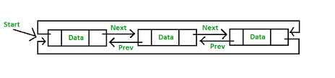
Doubly Circular Linked List
The doubly circular linked list has the features of both the circular linked list and doubly linked list.
It is a doubly linked list also because each node holds the address of the previous node also.
The main difference between the doubly linked list and doubly circular linked list is that the doubly circular linked list does not contain the NULL value in the previous field of the node.

